Slide 1
Final Presentation
Notes:
NEW CHAPTER

Slide 2
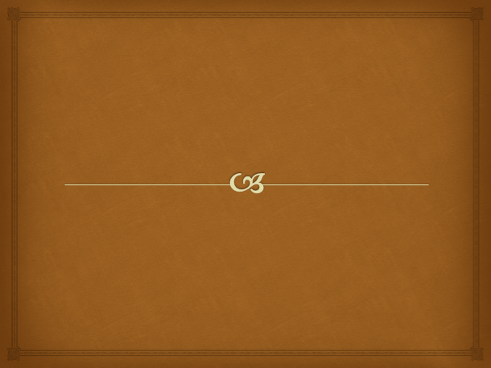
resources/presentation/FrontCover.png
D6 Digital
resources/presentation/FrontCoverBullet.png
Grimoire Interactive Rule Book
Notes:
Front Cover

Slide 3
Notes:
Introduction Video

Slide 4
resources/presentation/FrontCover.png
D6 Digital
resources/presentation/FrontCoverBullet.png
Grimoire Interactive Rule Book
Notes:
Front Cover 2

Slide 5


resources/presentation/SlideBackground.png
D6 Digital
resources/presentation/BulletPoint.png
Electronic Engineering undergraduates \nWide ranging skill sets
resources/presentation/BulletPoint.png
resources/presentation/MinorBulletPoint.png
Agile Development\nProgramming \nProject Management\nMultimedia and Interactivity
resources/presentation/MinorBulletPoint.png
resources/presentation/MinorBulletPoint.png
resources/presentation/MinorBulletPoint.png
Notes:
D6 Digital

Slide 6
resources/presentation/SlideBackground.png
Grimoire
resources/presentation/BulletPoint.png
Develop a presentation player\nTargeted towards the role playing community\nInteractive version of Rule Book \nSmooth gameplay \nIntroduce new players through ease of play
resources/presentation/BulletPoint.png
resources/presentation/BulletPoint.png
resources/presentation/BulletPoint.png
resources/presentation/BulletPoint.png
Notes:
Grimoire

Slide 7
resources/presentation/SlideBackground.png
Gameplay
resources/presentation/BulletPoint.png
Portrays information in book using multimedia \nVideo, sounds, text, graphics and images \nUtilities to assist players with game mechanics \nCalculator and dice roller \nMusic player to add depth to gameplay
resources/presentation/BulletPoint.png
resources/presentation/BulletPoint.png
resources/presentation/BulletPoint.png
resources/presentation/BulletPoint.png
Notes:
Gameplay

Slide 8

resources/presentation/SecondaryBackground.png
Demo
Notes:
Demo

